Slide 1
PYTHON PROJECT
SUBMITTED BY:
EGA AKSHITHA

Slide 2
OVERVIEW
Definition:
Healthcare refers to the organized provision of medical services to maintain or improve people’s health through prevention, diagnosis, treatment, and rehabilitation. It involves both the science (medical knowledge, technology) and the system (infrastructure, professionals, policies) that deliver care.
2. Main Components:
Primary Care → First contact care (general physicians, clinics, preventive services).
Secondary Care → Specialized care (cardiologists, dermatologists, hospitals).
Tertiary Care → Highly specialized services (cancer treatment, neurosurgery).
Quaternary Care → Cutting-edge experimental medicine, rare treatments.

Slide 3
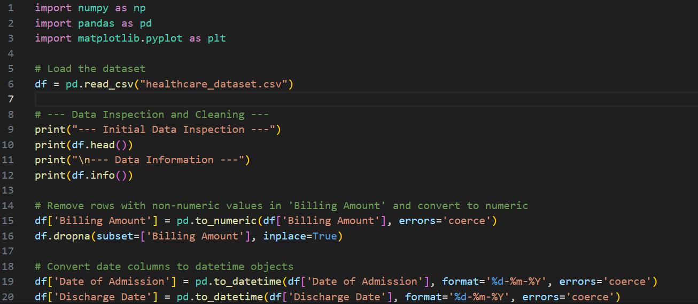
SOURCE CODE

Slide 4
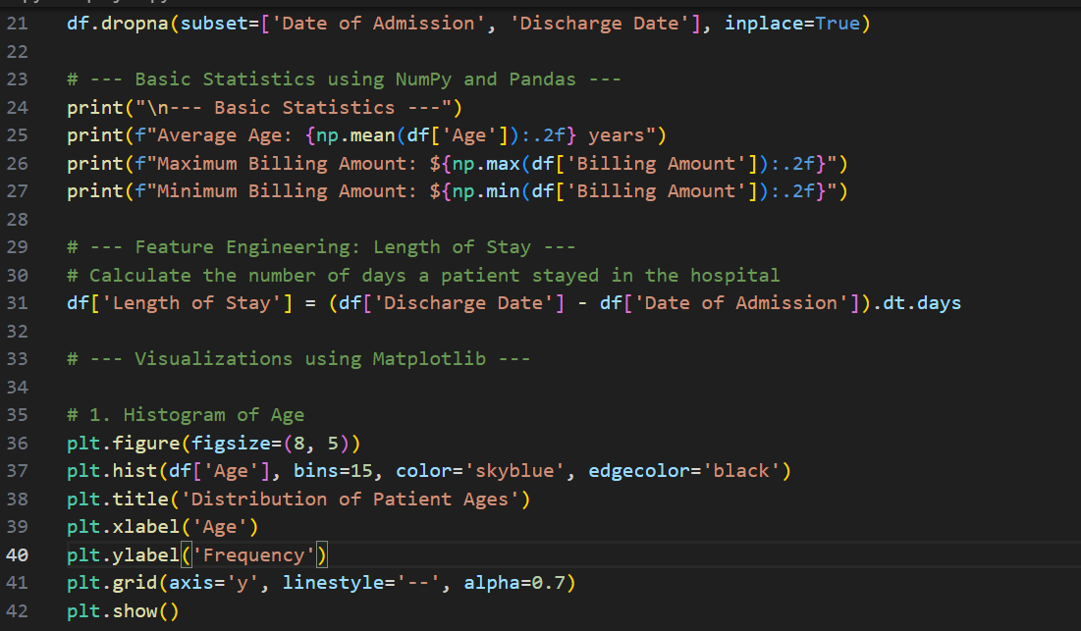

Slide 5
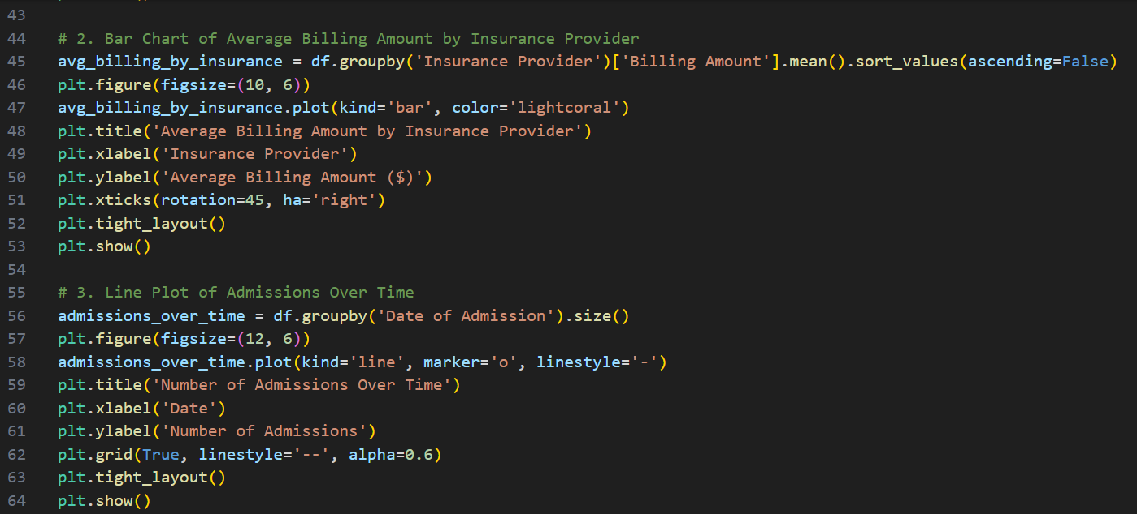

Slide 6
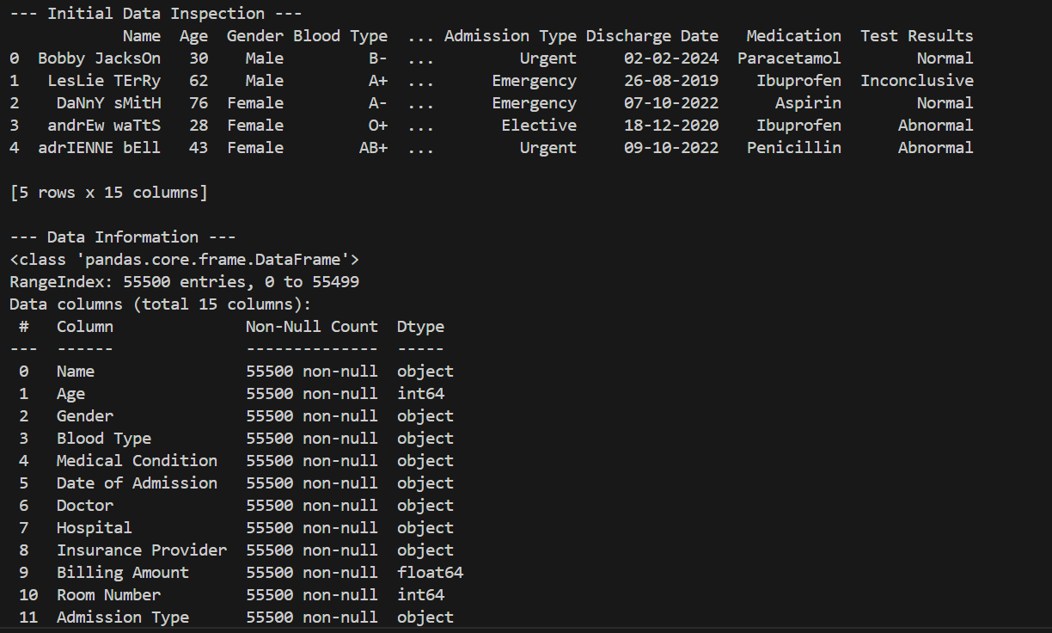
OUTPUT

Slide 7
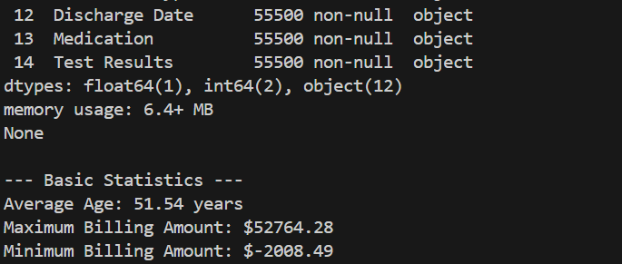

Slide 8
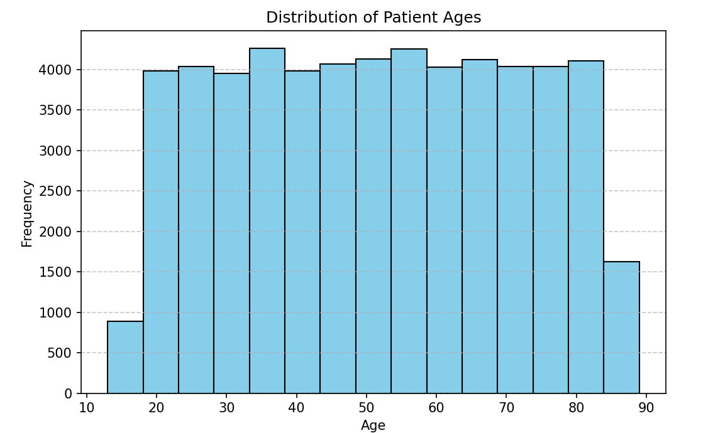

Slide 9
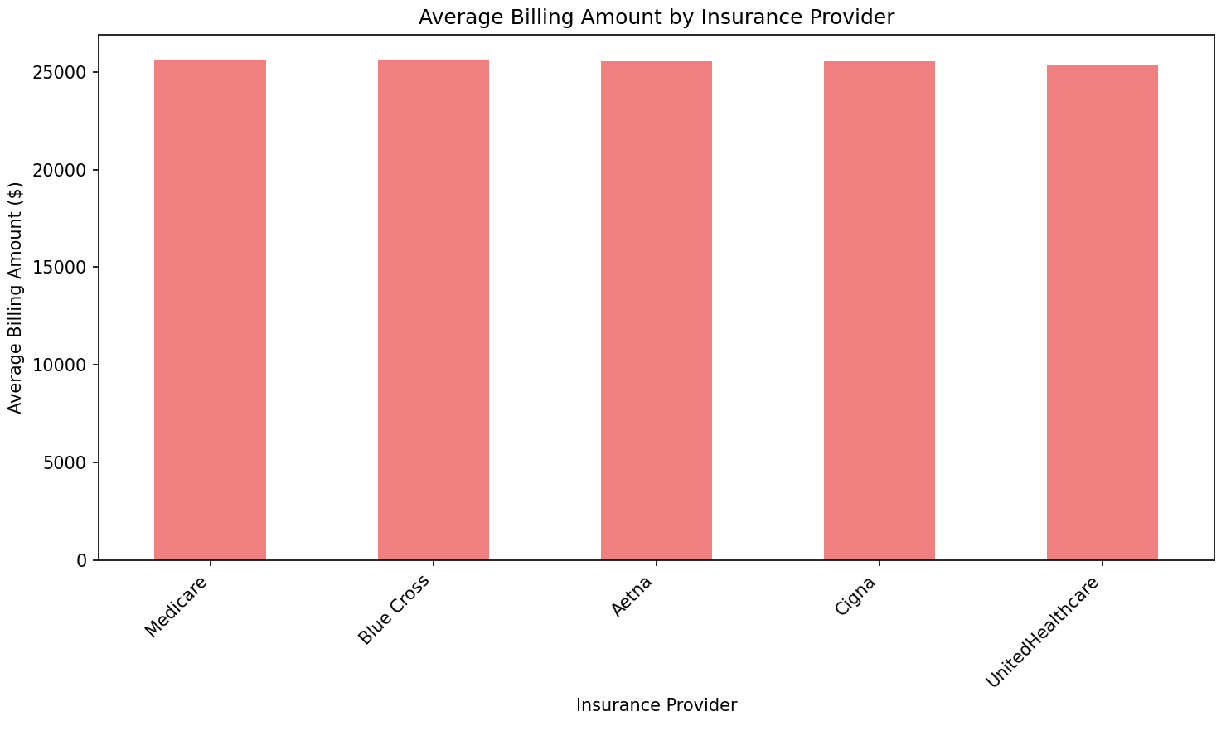

Slide 10
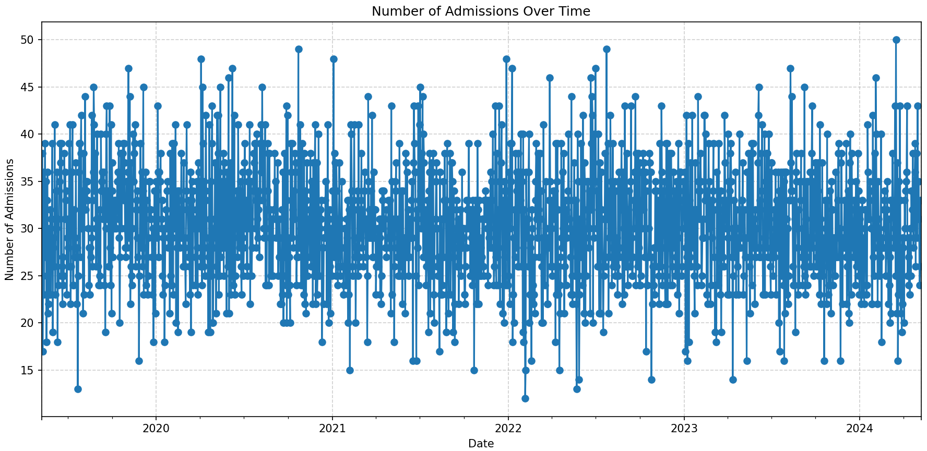

Slide 11
THANK YOU

